Slide 1
HIV Fundamentals
Bluefield State College
August 18, 2020
Carolyn Kidd RN ACRN
Clinical Nurse Educator
MidAtlantic AETC

Slide 2
Speaker Disclosure
Speakers are required to disclose any commercial relationships before today’s presentation.
Notes:
*Start Audio*
At this time I would ask our speaker to please disclose any commercial relationships that he/she may have.

Slide 3
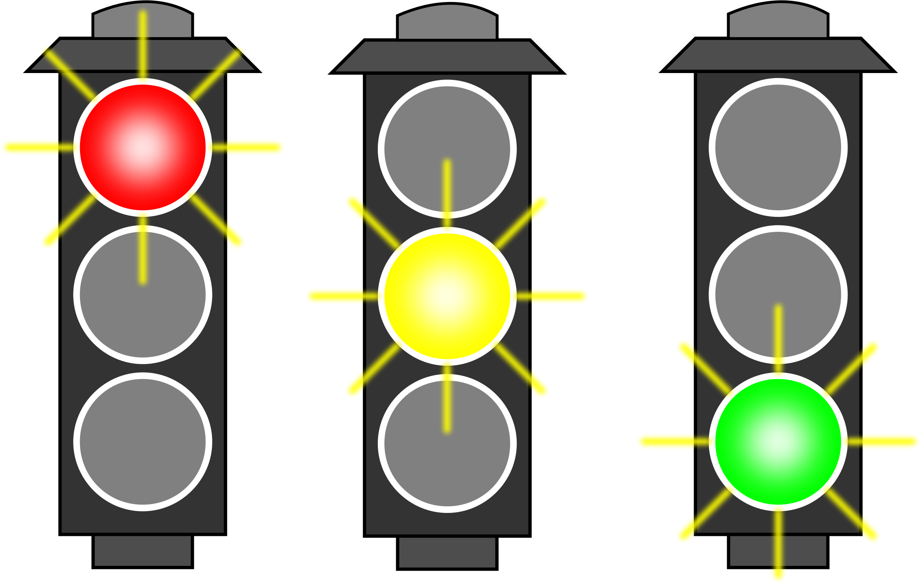
Lets Play ☺

Slide 4

Red light, green light game
This game is related to transmission of HIV:
  Facts, falsehoods and misconceptions
How to play:
  I’ve chosen several different risk factor behaviors related to HIV transmission. I’ll have one slide for each risk factor and you will determine via polling ability whether it is:
    Red check (No = not a good idea, stop) = high risk
    Gray check (go slower) = potential risk
    Green icon = for little/no risk
  We will discuss the poll responses to each slide

Slide 5
Let’s get started!
Number of sexual partners
    Red icon for high risk
    Gray icon for potential risk
    Green icon for little/no risk

Slide 6
Baby born to a woman with HIV
    Red icon for high risk
    Gray icon for potential risk
    Green icon for little/no risk

Slide 7
Unprotected sex
    Red icon for high risk
    Gray icon for potential risk
    Green icon for little/no risk

Slide 8
Sharing or buying breastmilk for personal use
    Red icon for high risk
    Gray icon for potential risk
    Green icon for little/no risk

Slide 9
Presence of Sexually Transmitted Infections
    Red icon for high risk
    Gray icon for potential risk
    Green icon for little/no risk

Slide 10
Intimate Partner Violence
    Red icon for high risk
    Gray icon for potential risk
    Green icon for little/no risk

Slide 11
Clean syringes and works for persons who inject substances
    Red icon for high risk
    Gray icon for potential risk
    Green icon for little/no risk

Slide 12
Sexual intercourse with a person with HIV whose viral load is suppressed
    Red icon for high risk
    Gray icon for potential risk
    Green icon for little/no risk

Slide 13
Blood donation
    Red icon for high risk
    Gray icon for potential risk
    Green icon for little/no risk

Slide 14
Alcohol and substance misuse
    Red icon for high risk
    Gray icon for potential risk
    Green icon for little/no risk

Slide 15
Women who have sex with other women
    Red icon for high risk
    Gray icon for potential risk
    Green icon for little/no risk

Slide 16
HIV-1 Infection
Initial description and early spread:
  Morbidity and Mortality Weekly Report (MMWR) June 5 1981, described Pneumocystis jiroveci pneumonia in men who have sex with men (MSM), LA and NYC
  July 1981, patients with Kaposi’s sarcoma reported
  Many causes considered: lifestyle, other infectious agents, drug abuse
  HIV itself was not identified for another 2 years¹
    The HIV epidemic spread rapidly and silently in the absence of testing
  Problem became designated as Acquired Immune Deficiency Syndrome (AIDS)

Slide 17
HIV-1 Infection
Background:
  Blood-borne, sexually transmissible
    Typically sexual intercourse, shared IV drug paraphernalia, mother to child (MTCT)
  Most common route of infection varies from country to country, within cities (depends on how HIV was introduced initially and local practices)
  Two distinct species HIV-1 and HIV-2
    each has it’s own genes and distinct replication process

Slide 18
HIV-1 Infection
  1982 four identified risk factors:
  homosexuality, IV drug abuse (heroin), Haitian origin, Hemophilia A
  GRID used by media & HCP , mistakenly suggesting inherent link b/t homosexuality and the “Syndrome”
  1983 US Public Health Service issues prevention recommendations:
  sexual transmission, transfusions
  CDC adds female sex partners of men with AIDS as 5th risk group
  1984: San Francisco orders bathhouses closed
  CDC recommends abstention from IV substance misuse/reduction in needle sharing

Slide 19
HIV-1 Infection
1985
  CDC releases 1st recommendations for prevention of Mother-To-Child-Transmission (MTCT)
  1st screening tool to detect HIV antibodies approved by FDA
  Screening of US blood supply
  Ryan White speaks publically against AIDS stigma/discrimination

Slide 20
HIV-1 Infection
1986
  AZT, the 1st drug used to treat AIDS, begins clinical trials
  Informal distribution of clean syringes begins in Boston & New Haven

Slide 21
HIV-1 Infection
1987
1st ARV approved by the FDA to treat AIDS:
  accelerated drug approval
  ACT UP established in NYC in response to proposed cost of AZT:
    price lowered
HIV Prevention: a new indicator for condom use

Slide 22
HIV-1 Infection
1989-1990
  1989: 1st guidelines issued for prevention of Pneumocyctis Jiroveci Pneumonia (PCP)
  1990: Beginning to see information regarding women and HIV

Slide 23
HIV-1 Infection
1991-1996
1991: Red ribbon introduced as the international symbol of AIDS awareness
1993: USPHS recommends use of AZT in pregnancy to reduce perinatal transmission (ACTG 076)
1996: Viral load analysis approved by the FDA

Slide 24
HIV-1 Infection
1997-98
  1997: AIDS-related deaths decrease by >40% due to Highly Active Anti-retroviral Therapy (HAART)
  1998: beginning to see growing signs of treatment failure/side effects of HAART

Slide 25
HIV-1 Infection
2002-2012
2002: women comprise about ½ of adults living with HIV globally
2004: Ora-Quick rapid HIV test approved by the FDA
2011: Results from the HPTN 052 trial show that early initiation of antiretroviral treatment reduces the risk of HIV transmission by 96% among discordant couples
  Pre-exposure prophylasis (PrEP)
2012: UNAIDS release new guidelines regarding ARV treatment as prevention, for serodiscordant couples

Slide 26
HIV-1 Infection
2013-2016
2013: UNAIDS reports AIDS-related deaths down 30 percent since their peak in 2005
2014: UNAIDS report shows that 19 million of the 35 million people thought to be living with HIV do not know their status
2015: START trial data released, PrEP
  Strategic Timing of Antiretroviral Treatment
2016: START is now standard of care

Slide 27
HIV-1 Infection
2017-2019
2017, 2018, 2019:
  New HIV drugs and drug class, dual therapies, new prevention models
  national case decreases but still stagnant
  HIV outbreaks among intravenous drug users (IDUs)
  syringe services programs

Slide 28

HIV/AIDS

Slide 29
Epidemiology of HIV/AIDS in the United States

Slide 30
HIV in the United States 2017
About 1.12 million people with HIV
  1 in 8 unaware of their infection (12.8%)
New HIV cases:
35-40,000 every year…. Stagnant but increased diagnoses in some populations in the US
Ages 25-34 years account for 13,433 new diagnoses
Gay, bi- and other MSM particularly, young black MSM, are most seriously affected by HIV
By race, blacks face the most severe burden of HIV
  12% US population, 44% new infections
  Unless the epidemic course changes, at some lifetime point 1 in 16 black men and 1 in 32 black women will be diagnosed with HIV

Slide 31
HIV in the United States 2019
Black MSM in the US most profoundly affected
Demographic: deep south
Behavioral: unprotected receptive anal sex
Economic: ↓ employment rates, ↓ college education, ↓ income
Biological: ↑ prevalence of STIs, rectal lining thin
Urgent need for better promotion of sexual health, prevention interventions, addressing socioeconomic, behavioral health to decrease HIV incidence…..

Slide 32
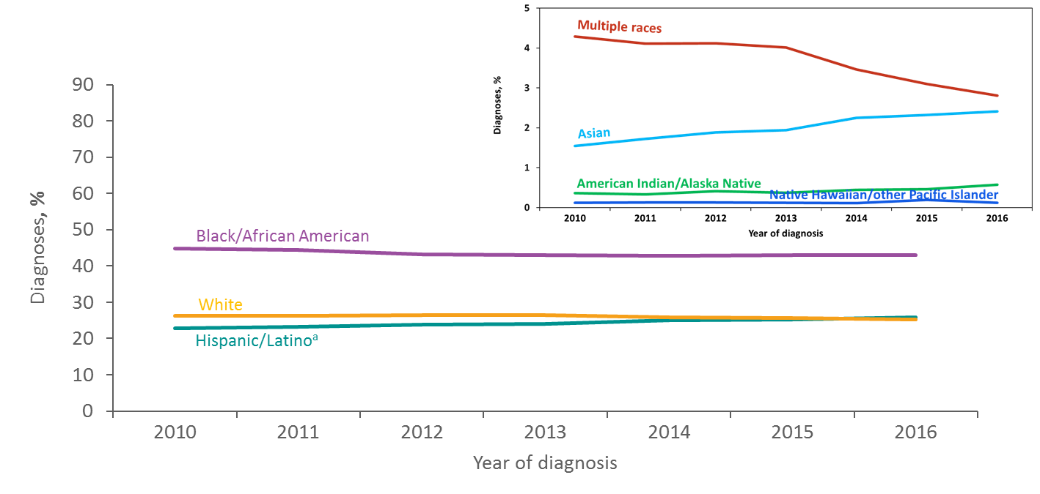
Diagnoses of HIV Infection among Adults and Adolescents, by Race/Ethnicity 2010–2016—United States and 6 Dependent Areas
ª Hispanics/Latinos can be of any race.
Notes:
From 2010 through 2016, blacks/African Americans accounted for the largest percentage of diagnoses of HIV infections each year in the United States and 6 dependent areas.
In 2016, 43% of diagnoses were among blacks/African Americans, 26% among Hispanics/Latinos, 25% among whites, 3% among persons of multiple races, 2% among Asians, and less than 1% each for American Indians/Alaska Natives and Native Hawaiians/other Pacific Islanders. For the first time in 2016, the proportion of diagnoses that were among Hispanics/Latinos was greater than the proportion of diagnoses that were among whites.
Hispanics/Latinos can be of any race.

Slide 33
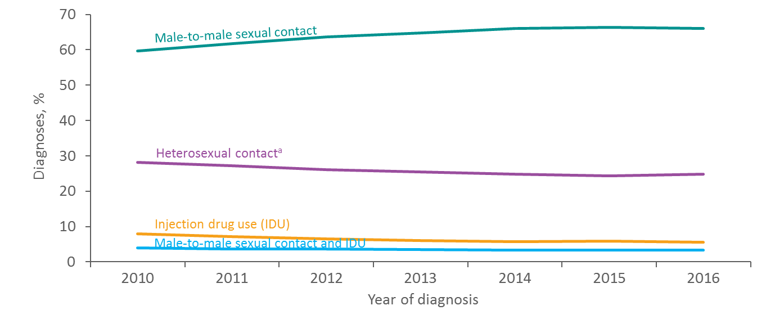
Diagnoses of HIV Infection among Adults and Adolescents, by Transmission Category, 2010–2016—United States and 6 Dependent Areas
Note. Data have been statistically adjusted to account for missing transmission category. “Other” transmission category not displayed as it comprises less than 1% of cases.
ª Heterosexual contact with a person known to have, or to be at high risk for, HIV infection.
Notes:
This slide presents the percentage distribution of adults and adolescents with diagnosed HIV infection from 2010 through 2016, by transmission category, for the United States and 6 dependent areas.
The percentage of adults and adolescents with diagnosed HIV infection attributed to male-to-male sexual contact increased from 60% in 2010 to 66% in 2016. The percentages of diagnosed HIV infections attributed to injection drug use, male-to-male sexual contact and injection drug use, and heterosexual contact decreased from 2010 through 2016. The “Other” transmission category is not displayed as it comprises less than 1% of cases. The category includes hemophilia, blood transfusion, perinatal exposure, and risk factor not reported or not identified.
Data have been statistically adjusted to account for missing transmission category.
Heterosexual contact is with a person known to have, or to be at high risk for, HIV infection.

Slide 34
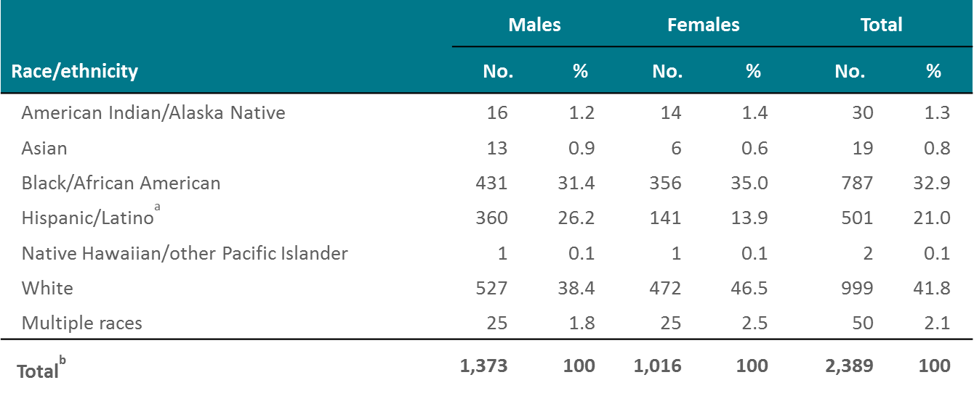
Diagnosed HIV Infections Attributed to Injection Drug Use, by Sex and Race/Ethnicity, 2017—United States and 6 Dependent Areas
Note. Data for the year 2017 are considered preliminary and based on 6 months reporting delay. Data have been statistically adjusted to account for missing transmission category.
ª Hispanics/Latinos can be of any race.
^{b} Because column totals for numbers were calculated independently of the values for the subpopulations, the values in each column may not sum to the column total.
Notes:
In 2017, approximately 2,389 diagnosed HIV infections in the United States and 6 dependent areas were attributed to injection drug use.
Overall, over one-third of diagnosed HIV infections attributed to injection drug use were among whites (42%). When separated by sex, 38% of males and 47% of females were white. Blacks/African Americans accounted for 31% of infections for males and 35% for females. Hispanics/Latinos accounted for 26% of infections for males and 14% for females.
Persons of multiple races accounted for approximately 2% of diagnosed infections for males and 3% for females. American Indians/Alaska Natives accounted for approximately 1% for both males and females. Asians accounted for approximately 1% for both males and females. Native Hawaiians/other Pacific Islanders accounted for less than 1% for both males and females.
Data for the year 2017 are considered preliminary and based on 6 months reporting delay. Data have been statistically adjusted to account for missing transmission category. Because column totals for numbers were calculated independently of the values for the subpopulations, the values in each column may not sum to the column total.
Hispanics/Latinos can be of any race.

Slide 35
WV HIV/AIDS Surveillance Summary
Updated 2018: Cumulative through 2017
HIV not AIDS: 1144
HIV/AIDS: 1870
By gender
  Male 853
  Female 291
By race
  White 733
  African American 344
  Hispanic 32
  Other: includes hemophilia, blood transfusion, and risk not reported or not identified 154
Notes:
Data are provisional and may vary in time due to new cases that are received and/or lost to other states. All data excludes individuals who currently reside in federal prison.

Slide 36
WV HIV/AIDS Surveillance Report
Updated 2017
Exposure category
  MSM 568⇧
  Injection drug use (IDU) could this be an ongoing concern in the era of COVID19?
  MSM/IDU 50
  Heterosexual contact 180
  Perinatal 13
  Other/Unknown 154
    Includes hemophilia, blood transfusion, risk not reported

Slide 37
HIV Transmission

Slide 38
Modes of Transmission
Sexual contact (unprotected)
  M-M: (most frequently reported risk)
  M-F or vice versa
  F-F
Blood exposure
  Substance Use Disorder: Injection Drug Use/Needle sharing
  Occupational
  Transfusion
Mother to Child (MTCT )
  Vertical
  Breastfeeding

Slide 39
Biological Factors That Affect Sexual Transmission
Blood and genital viral load suppression
Acute infection or advanced disease
Genital ulcerations
Inflammatory STIs: acquisition of HIV
Cervical ectopy: covered by a single layer of columnar epithelium that is:
  Highly susceptible to HIV
  The site of HIV receptor cells (CCR5)
HAART (Highly Active Anti-Retroviral Therapy)

Slide 40
Infectious Body Fluids
Blood
Semen
Vaginal secretions
Breastmilk

Slide 41
Other Body Fluids
Considered potentially infectious:
  Cerebrospinal
  Synovial
  Pleural
  Peritoneal
  Pericardial
  Amniotic
  Pus

Slide 42
Other Body Fluids
Not infectious unless visibly bloody:
  feces, urine
  nasal secretions, sputum
  saliva
  sweat
  tears
  vomitus
Notes:
What to say here about Hepatitis?

Slide 43
Stages of Infection

Slide 44
Natural History of HIV Infection
Viral Transmission
  Virus immediately harbored in the gut-associated lymphoid tissue (GALT)
  Within 2-3 wks leads to:
Acute HIV infection
  Peak viremia
  sx may last about 1-2 weeks
Recovery and seroconversion
Asymptomatic chronic HIV infection
  avg 8 years
Symptomatic HIV infection
  avg 1.3 years
AIDS
Death

Slide 45
Lab tests to support therapy in HIV infection
Viral Load Assay:
  Indicates the current level of circulating virus
CD4 T cell counts:
  Measure the current ability of the immune system to protect the body
Combination of the 2 provides the best information for initiating, monitoring and changing Highly Active Antiretroviral Therapy (HAART)

Slide 46
Acute HIV Infection (AHI)
Symptoms 2-3 weeks after exposure
Can last 1-2 weeks
Most symptoms usually resolve within 2 weeks w/o treatment
Generally accepted: most clients will experience symptoms during this phase
Persistence of symptoms may predict a more rapid progression to AIDS

Slide 47
AHI
Very high degree of viremia (millions of virus particles)
CD4 decreases by 20-40% due to HIV-induced cell death
Up to 90% have acute viral syndrome
Antibodies not present until after 1 mo.
Due to very high level of viremia: >50% sexual transmissions occur during AHI

Slide 48
AHI
Clinical presentation may mimic other febrile illnesses
Symptoms non-specific
Early diagnosis relies on history of exposure, viral load >50,000 copies/ml and a high degree of clinical suspicion

Slide 49
AHI:
Common Signs & Symptoms
N = 160 patients with PHI in
Geneva, Seattle, and Sydney
% of patients
Vanhems P et al. AIDS 2000; 14:0375-0381.

Slide 50
AHI:
Other Signs & Symptoms
% of patients
Kahn JO, Walker BD. N Engl J Med. 1998;339:33-39.

Slide 51
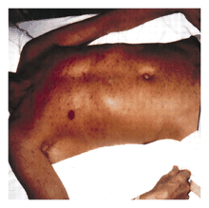
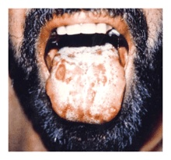
AHI
Rash
Mucosal Lesions
Trunk and face > limbs
Small pink macules
Oral ulcers, thrush
(Kahn, NEJM, 1998)

Slide 52
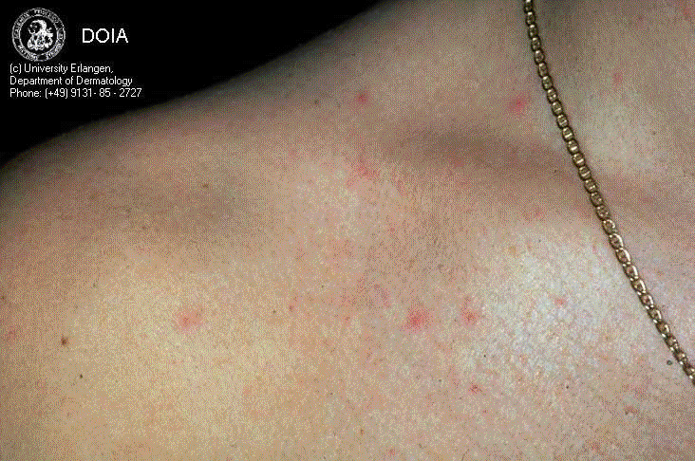

Slide 53
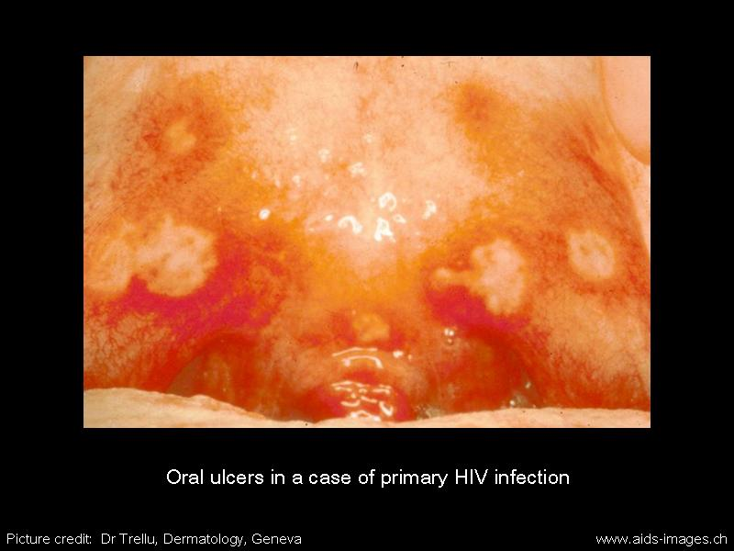

Slide 54
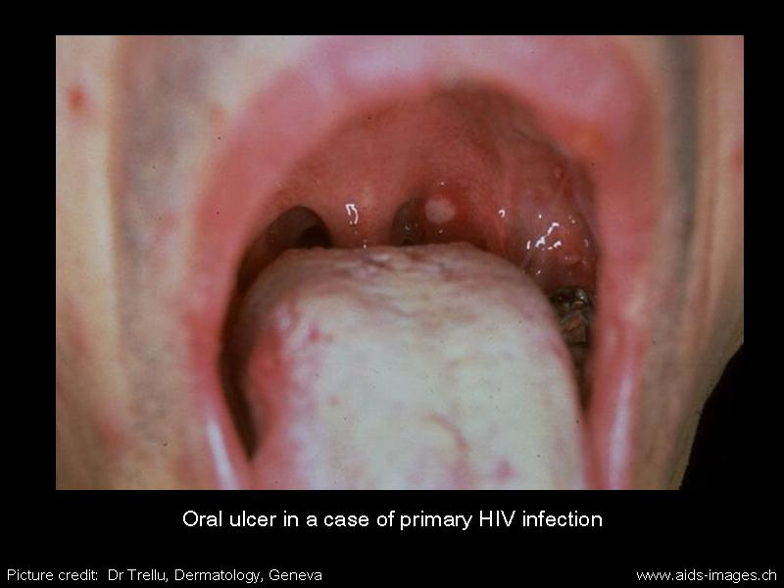

Slide 55
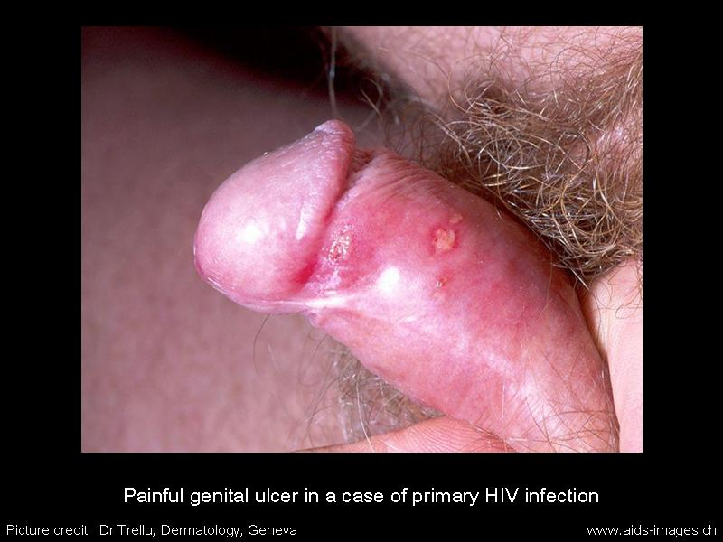

Slide 56
Should we care about diagnosing Acute HIV Infection (AHI)?
Yes! public health:
  Patients with AHI are highly infectious
    Dx of HIV infection may lead to safer sex: risk-reduction counseling can be instituted sooner
  Closer-than-usual proximity to date of exposure makes partner tracing more feasible
Yes! personal health:
  40% of patients with HIV not diagnosed until they are AIDS defined
  Antiretroviral therapy during AHI may alter the natural course of HIV disease by lowering the set-point

Slide 57
AHI: Clinicians be aware!!
Any non-specific viral syndrome should prompt healthcare providers to:
ask about risk
rule out HIV infection
Any oral or genital ulcer should raise suspicion:
ask about risk!

Slide 58
Clinical Latency
Average: 8 years
No signs and symptoms of illness
Virus is NOT dormant, active in the lymph nodes
HIV low level replication persists
Can be infected and not know:
  Increased risk of transmission to others r/t unknown HIV status

Slide 59
Symptomatic HIV
Low CD4 counts: <500
Stage where symptoms have begun to manifest, before development of AIDS
Constitutional symptoms appear; non-life threatening
Then development of AIDS defining Opportunistic Infections (Ois)
Absence of HAART: leads to death in 2-3 yrs

Slide 60
Symptomatic HIV Infection
Cyclic in nature
  Oral thrush
  Chronic vaginal yeast infections
  Cervical dysplasia
  Herpes Zoster (recurrent/multi-dermatomal)
  Weight loss <10% total body weight
  Fevers, lymphadenopathy

Slide 61
AIDS
Classification:
HIV + and CD4 count < 200 or…
HIV + and an AIDS defining illness
Final and most serious stage of HIV disease
Immune system severely damaged
Development of Opportunistic Infections (OIs)
Selected tumors
Wasting
Neurologic complications

Slide 62
Some AIDS Defining Conditions
Esophageal candidiasis
Cytomegalovirus
Pneumocystis jiroveci pneumonia
Cervical cancer
Toxoplasmosis of brain
HIV wasting syndrome (weight loss > 10%)
Tuberculosis
But …..
  People aren’t dying of AIDS-related illnesses anymore

Slide 63
Underlying causes of death
Globally:
  tuberculosis
Non-AIDS related cancers (lymphoma)
HCV/HIV co-infection complications
Cardiac
Renal complications

Slide 64
MidAtlantic AIDS Education and Training Center - Contact Information
Regional Partner: West Virginia
Contact Information:
Carolyn Kidd RN ACRN
304-293-6359
Headquarters:
MidAtlantic AIDS Education and Training Center
Department of Infectious Diseases and Microbiology,
Graduate School of Public Health,
University of Pittsburgh
412-624-1895
maaetc@pitt.edu
www.maaetc.org
Linda Rose Frank, PHD, MSN, ACRN, FAAN
Principal Investigator and Program Director
Professor of Public Health, Medicine & Nursing
University of Pittsburgh

